Slide 1

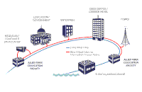
20ITT51 – Computer Networks
Handled by
Dr.T.Abirami
Associate Professor
Department of Information Technology
Kongu Engineering College

Slide 4
Network
It is a collection of two or more computers, that link together and communicate with each other, to enable sharing of information, data and resources.

Slide 5
Networks
Networks can be physically connected by cables or share a wireless connection.

Slide 6
Use of Network
Companies and organisations typically use networks to connect employees to one another and allow access to, and an open flow of, information across a department or business.

Slide 7
Network
Devices and technology could join computers on a network, including servers, mainframes, modems, routers, smartphones, webcams and printers.

Slide 8
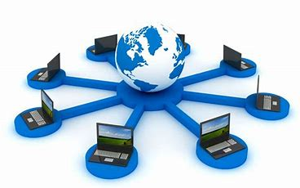
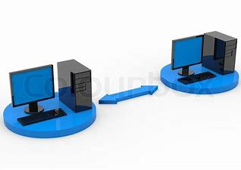
Computer networks have the following three goals:
Overcoming geographic separation
Allowing information sharing
Supporting distributed processing

Slide 9


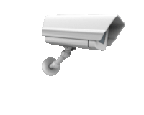


Important uses and benefits of a computer network
File sharing
Hardware sharing
Application sharing
User communication
Network gaming
Voice over IP (VoIP)

Slide 10
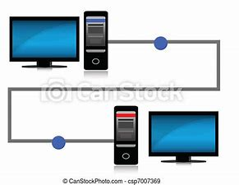
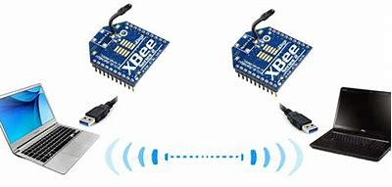
DATA COMMUNICATIONS
The exchange of data between two devices via some form of transmission medium such as a wire cable.

Slide 11
Devices:
Personal computers, mobile phones and laptops
devices are connected through a media to the network, which carry information from one end to other end.
Data can be any text, image, audio, video, and multimedia files.
Communication is an act of sending or receiving data.

Slide 12
Types of Data communication
Local - devices are in the same geographical area
Remote – communication between two or more devices not located at the same geographical area

Slide 13
Fundamental Characteristics
The effectiveness of a data communication system depend on four fundamental characteristics:
Delivery – data to the correct destination
Accuracy - Data delivered should be accurate.
Timelines – deliver data in timely manner
Jitter – Variation in the packet arrival time.

Slide 14
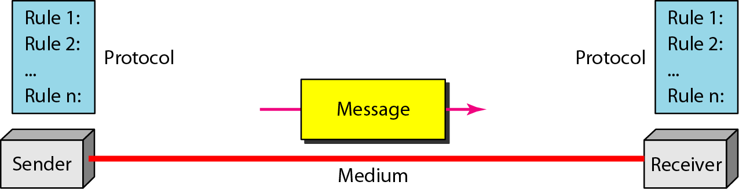
Components of a data communication system

Slide 15
SIMPLE DATA COMMUNICATION MODEL
Source : Where the data is originated.
Transmitter : Convert data into suitable form for transmission through the medium
Receiver : Which receives the signal and convert it into data or message.
Destination : where the data is sent.

Slide 16
Protocol
It is a set of rules that governs data communication.
It represents an agreement between the communicating devices.
Without a protocol, two devices maybe connected but not communicating

Slide 17
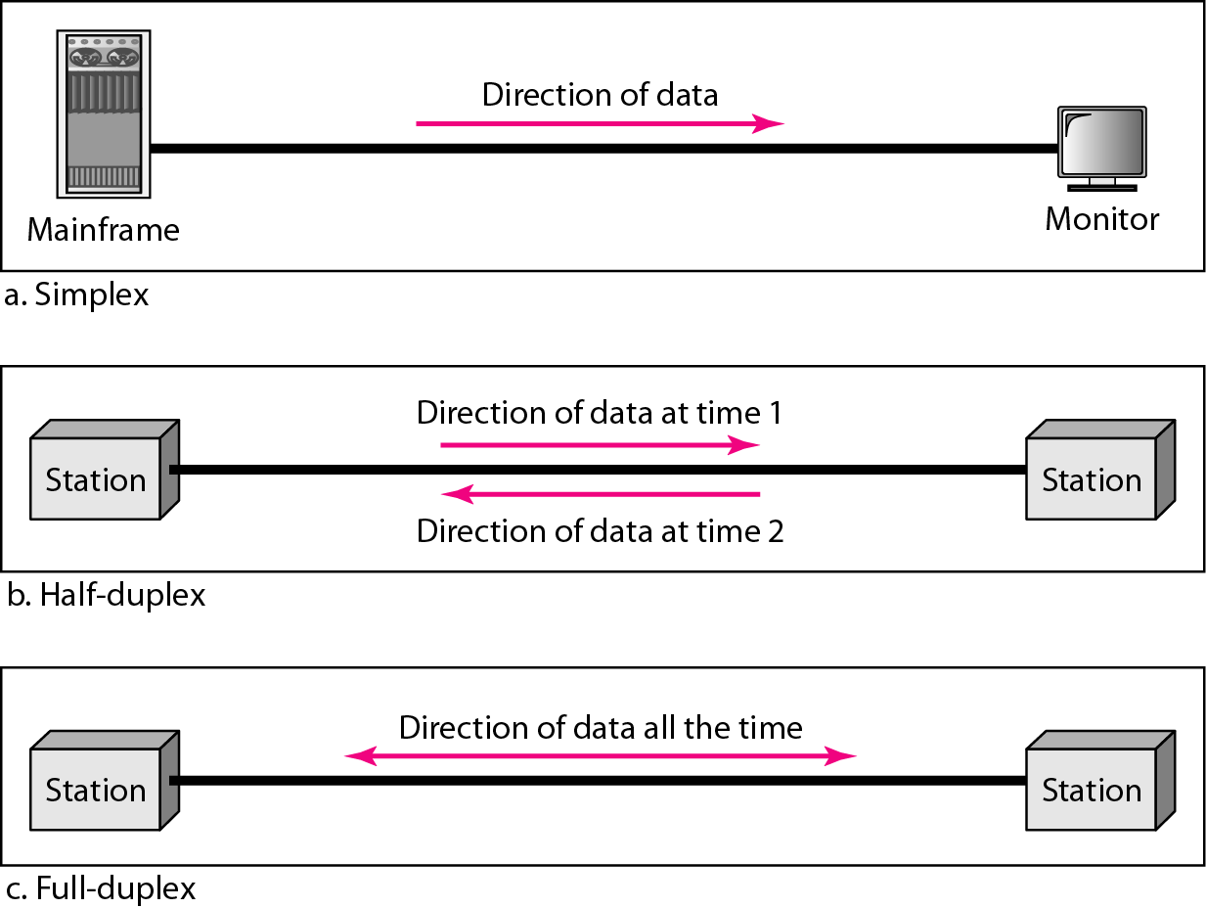
Data flow
Communication between two devices can be simplex, half-duplex, and full-duplex
Only one of the two device can transmit
Each station can both transmit and receive, but not same time

Slide 18
Data Representation
Text
- It is represented as a bit pattern
- sets of bit patterns – Each set is called
Unicode
- ASCII : first 127 characters in Unicode
- 2^7 (= 128) (11111111)
(Min value : 00000000
Max value : 11111111)

Slide 19
Parameters of Comparison | Unicode | ASCII
Definition | Unicode is the IT standard that encodes, represents, and handles text for the computers, telecommunication devices, and other equipment. | ASCII is the IT standard that encodes the characters for electronic communication only.
Abbreviation | Unicode is also known as Universal Character Set. | American Standard Code for Information Interchange is the full form of ASCII.
Function | Unicode represents a large number of characters such as letters of various languages, mathematical symbols, historical scripts, etc. | ASCII represents a specific number of characters such as uppercase and lowercase letters of English language, digits, and symbols.
Utilizes | It uses 8bit, 16bit, or 32 bit to present any character and ASCII is subordinate of Unicode. | It uses 7bits to present any character. It does so by converting the characters to numbers.
Space occupied | Unicode supports a large number of characters and occupies more space. | ASCII supports 128 characters only and occupies less space.

Slide 20
Data Representation
Numbers , Images are also represented by bit patterns
Audio - use a microphone to change voice or music to an electric signal, we create a continuous signal.
Video - continuous entity

Slide 21
NETWORKS
A network is a set of devices connected by communication links.
A node can be a computer, printer, or any other device capable of sending and/or receiving data generated by other nodes on the network.
A link can be a cable, air, optical fiber, or any medium which can transport a signal carrying information.
a device can be a host (or an end system as it is sometimes called) such as a large computer, desktop, laptop, workstation, cellular phone, or security system.

Slide 22
Networking Elements
At least two computers
Transmission medium either wired or wireless
Protocols or rules that govern the communication
Network software such as Network Operating System

Slide 23
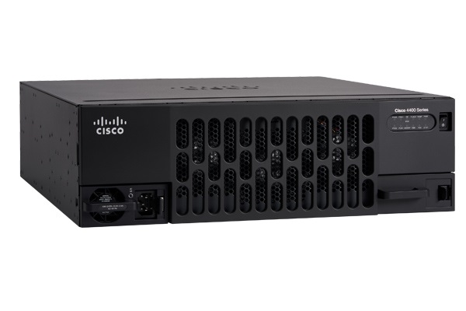
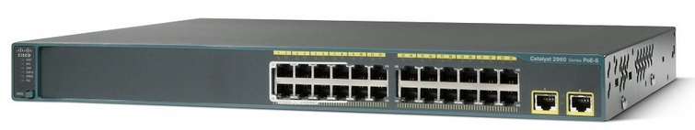
Connecting devices – Wired Medium
Switch -used to connects the devices together
Router- used to connects the network to other networks
Gateway - used to connect two or more dissimilar networks.

Slide 24
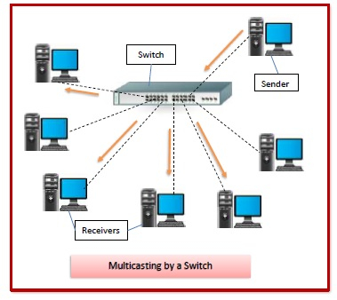

Slide 25
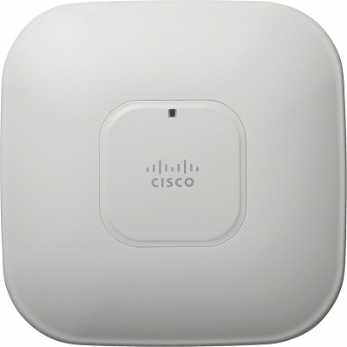
Connecting devices – Wired Medium
Access Point (AP) - used in wireless networks.
It is used to connect wirelessly connected devices to wired network.

Slide 26
Access point
It is a device that creates a wireless local area network, or WLAN, usually in an office or large building.
An access point connects to a wired router, switch, or hub via an Ethernet cable, and projects a WiFi signal to a designated area.

Slide 27
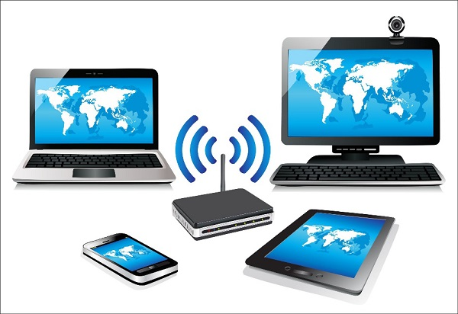
Wi-Fi Card
Wi-Fi is the acronym for wireless fidelity.
Wi-Fi technology is used to achieve wireless connection to any network.
Wi-Fi card is a card used to connect any device to the local network wirelessly.

Slide 28
Network Criteria
Performance
Reliability
Security

Slide 29
1. Performance
It is measured in terms of transit time and response time.
Transit time is the time for a message to travel from one device to another
Response time is the elapsed time between an inquiry and a response.
Performance is dependent on the following factors:
The number of users
Type of transmission medium
Capability of connected network
Efficiency of software

Slide 30
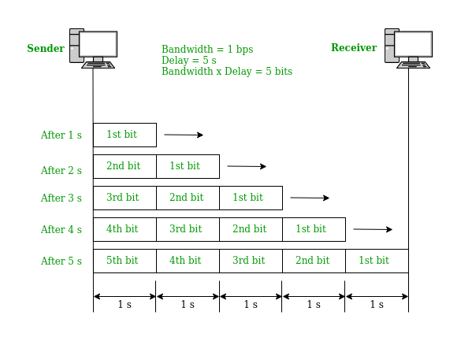
Parameters for Measuring Network Performance
Bandwidth (in Hertz , in Bits per Seconds)
Latency (Delay)
Throughput
Jitter

Slide 31
Latency (Delay)
the total time taken for a complete message to arrive at the destination,
starting with the time when the first bit of the message is sent out from the source and ending with the time when the last bit of the message is delivered at the destination.

Slide 32
JITTER
jitter is a “packet delay variance”.
when different packets of data face different delays in a network and the data at the receiver application is time-sensitive,
i.e. audio or video data. Jitter is measured in milliseconds(ms).

Slide 33
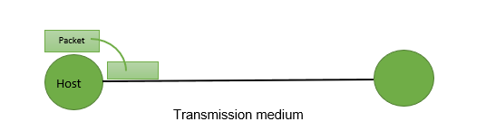
Performance
It is evaluated by two networking metrics:
Throughput : how much data is successfully transferred from source to destination
Delay : the amount of time it takes for a packet to go from source device to destination device.
Bandwidth is a measure of how much information a network can transfer.
Bandwidth is the data transfer capacity of a computer network in bits per second (Bps).

Slide 34
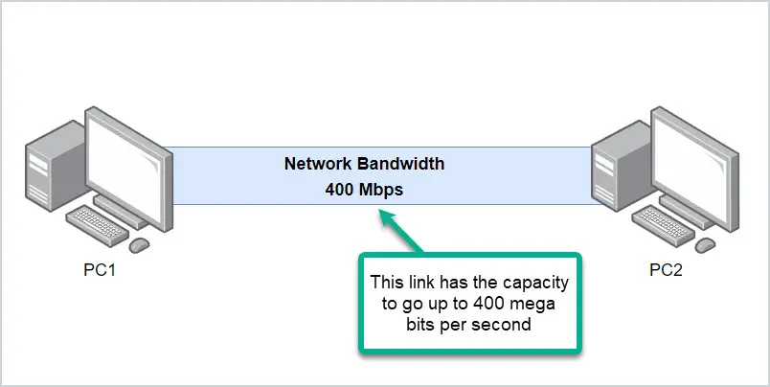
What is Network Bandwidth?
Bandwidth is the maximum amount of data that can be transmitted through a link, from a source to a destination.
It refers to the overall capacity of a network link
it has the overall capacity to transmit data at 400 Mbps.

Slide 35
Bandwidth
It is measured in bits per second and expressed as bps
Kbps (kilobits per second)
Mbps (megabits per second)
Gbps (gigabits per second)
Tbps (terabits per second).
kilo (1 kbit/s =1,000 bit/s),
mega (1 Mbit/s =1,000 kbit/s),
giga (1 Gbit/s = 1,000 Mbit/s)
tera (1 Tbit/s = 1,000 Gbit/s)

Slide 36
How to Convert Bits and Bytes
8 bits = 1 byte
1,024 bytes = 1 kilobyte
1,024 kilobytes = 1 megabyte
1,024 megabytes = 1 gigabyte
1,024 gigabytes = 1 terabyte

Slide 37
example
To convert 5 kilobytes into bits,
Step 1 : use the second conversion to get 5,120 bytes (1,024 X 5) and
Step 2 : then the first to get 40,960 bits
(5,120 X 8).

Slide 38
Reliability
It is measured in terms of
Frequency of failure
Recovery from failures
Robustness during catastrophe

Slide 39
Security
It means protecting data from unauthorized access.

Slide 40
Applications
Resource Sharing:
Server-Client model:
Communication Medium:
eCommerce
Home Applications
Mobile Users

Slide 41
Physical Structures (network attributes)
Type of Connection
Point to Point - single transmitter and receiver
establishing a point-to-point connection between the remote control and the television’s control system.
Multipoint - multiple recipients of single
transmission

Slide 42
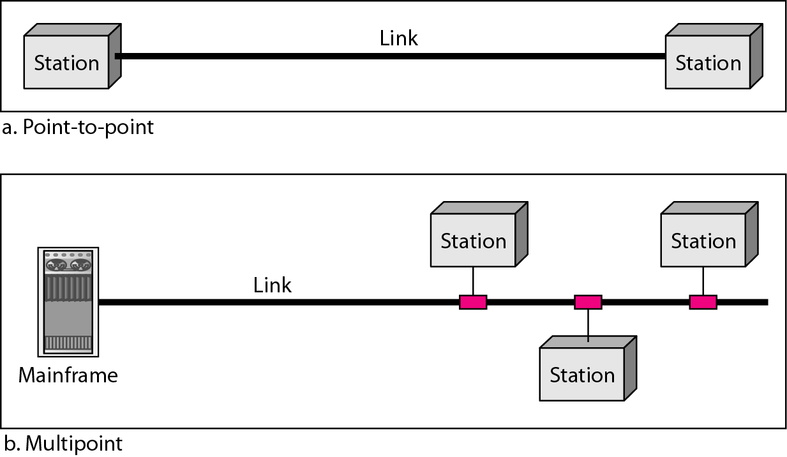
Types of connections: point-to-point and multipoint

Slide 43
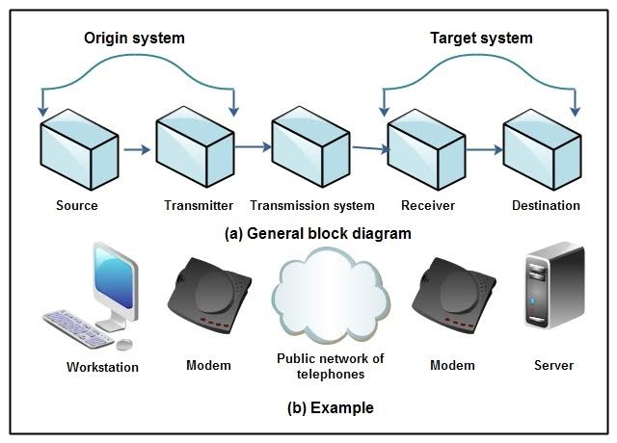

Slide 44
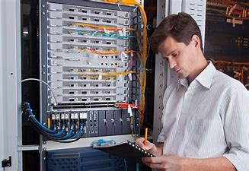
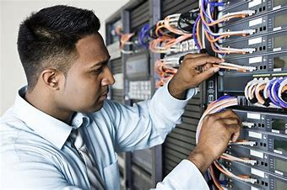
Some Popular Job Profiles in Networking:
Network Administrators
Network Support Engineer
Network Specialist
Network Security Engineer
Network Managers
System Engineers

Slide 45

Popular Employer for Network Engineers
HCL Technologies Ltd.
Ericsson Inc.
Wipro
Wipro Technologies Ltd.
Cisco Systems Inc
HCL Infosystem Ltd.
Accenture
Tata Communications Ltd
Dimension Data
Aricent Inc
Vodafone
Nokia Siemens Networks
Cisco Systems (India) PrivateLimited
Techmahindra Ltd

Slide 46
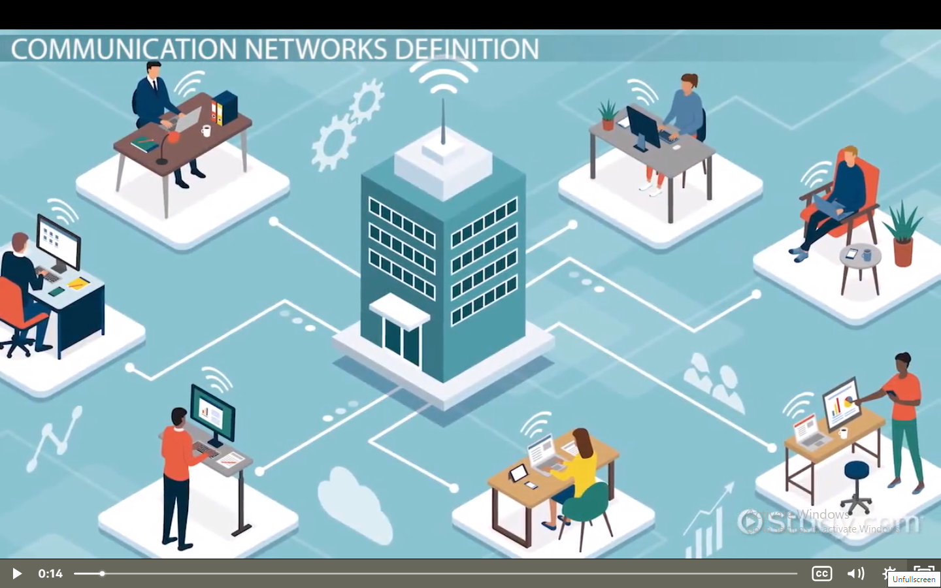

Slide 47


